Slide 1
Project Tracking with a Hierarchical Database Model
TRB Transportation Planning Applications Conference
June 2019
Seth Hostetter
Director Safety Analytics & Mapping
Office of Research, Implementation & Safety

Slide 2
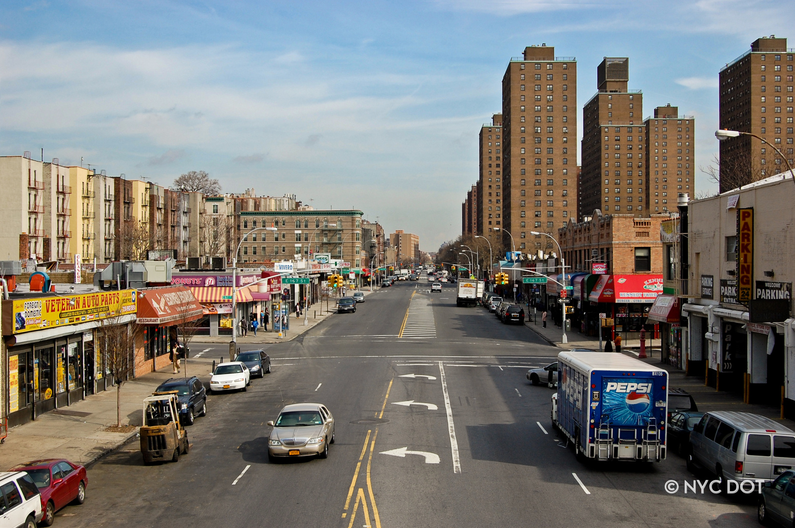
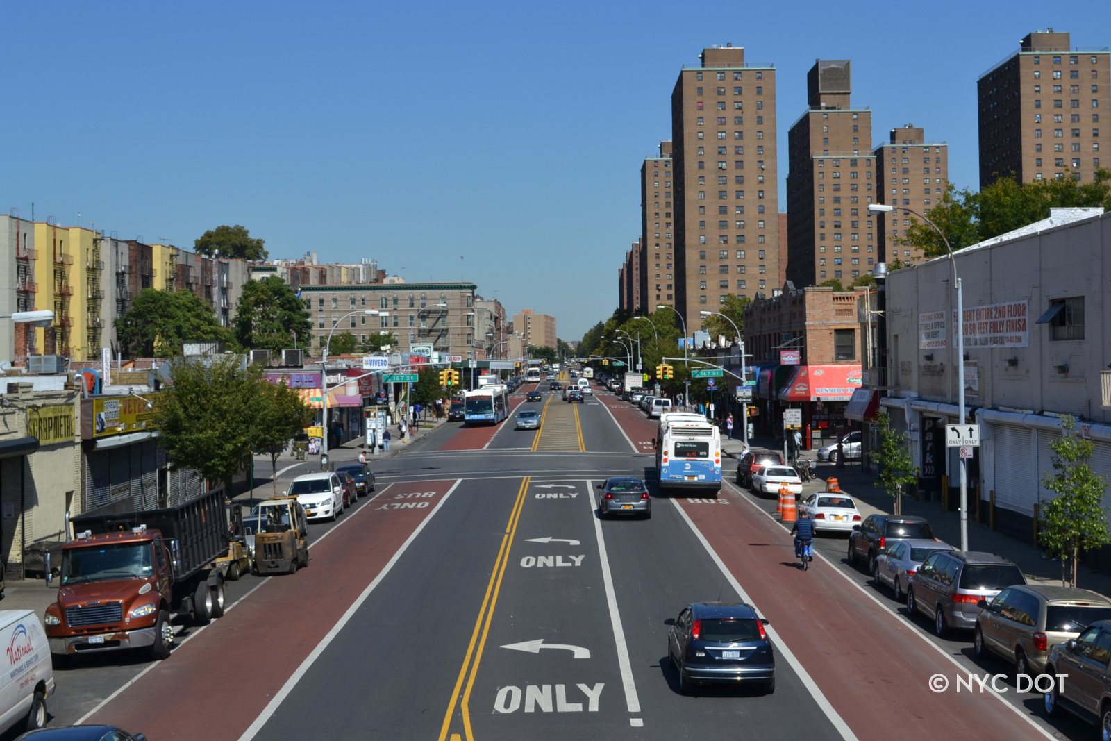
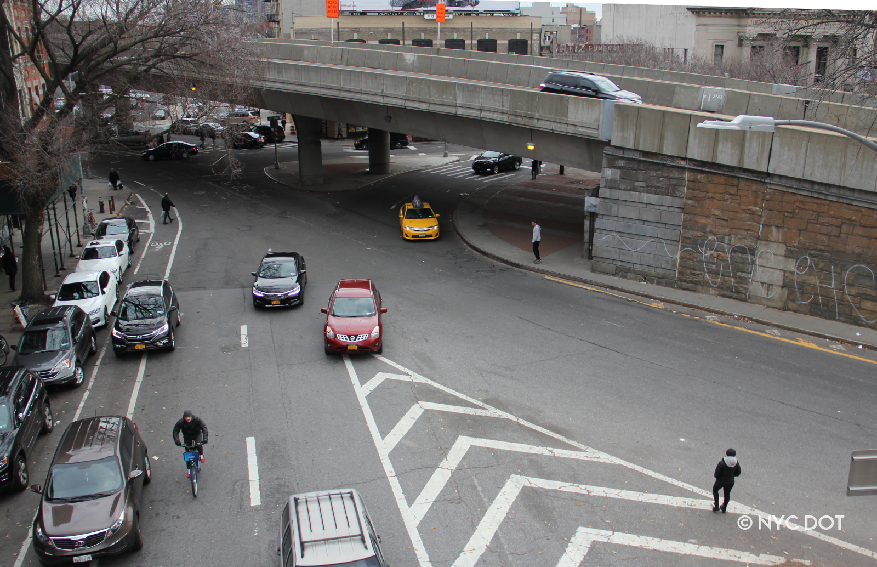
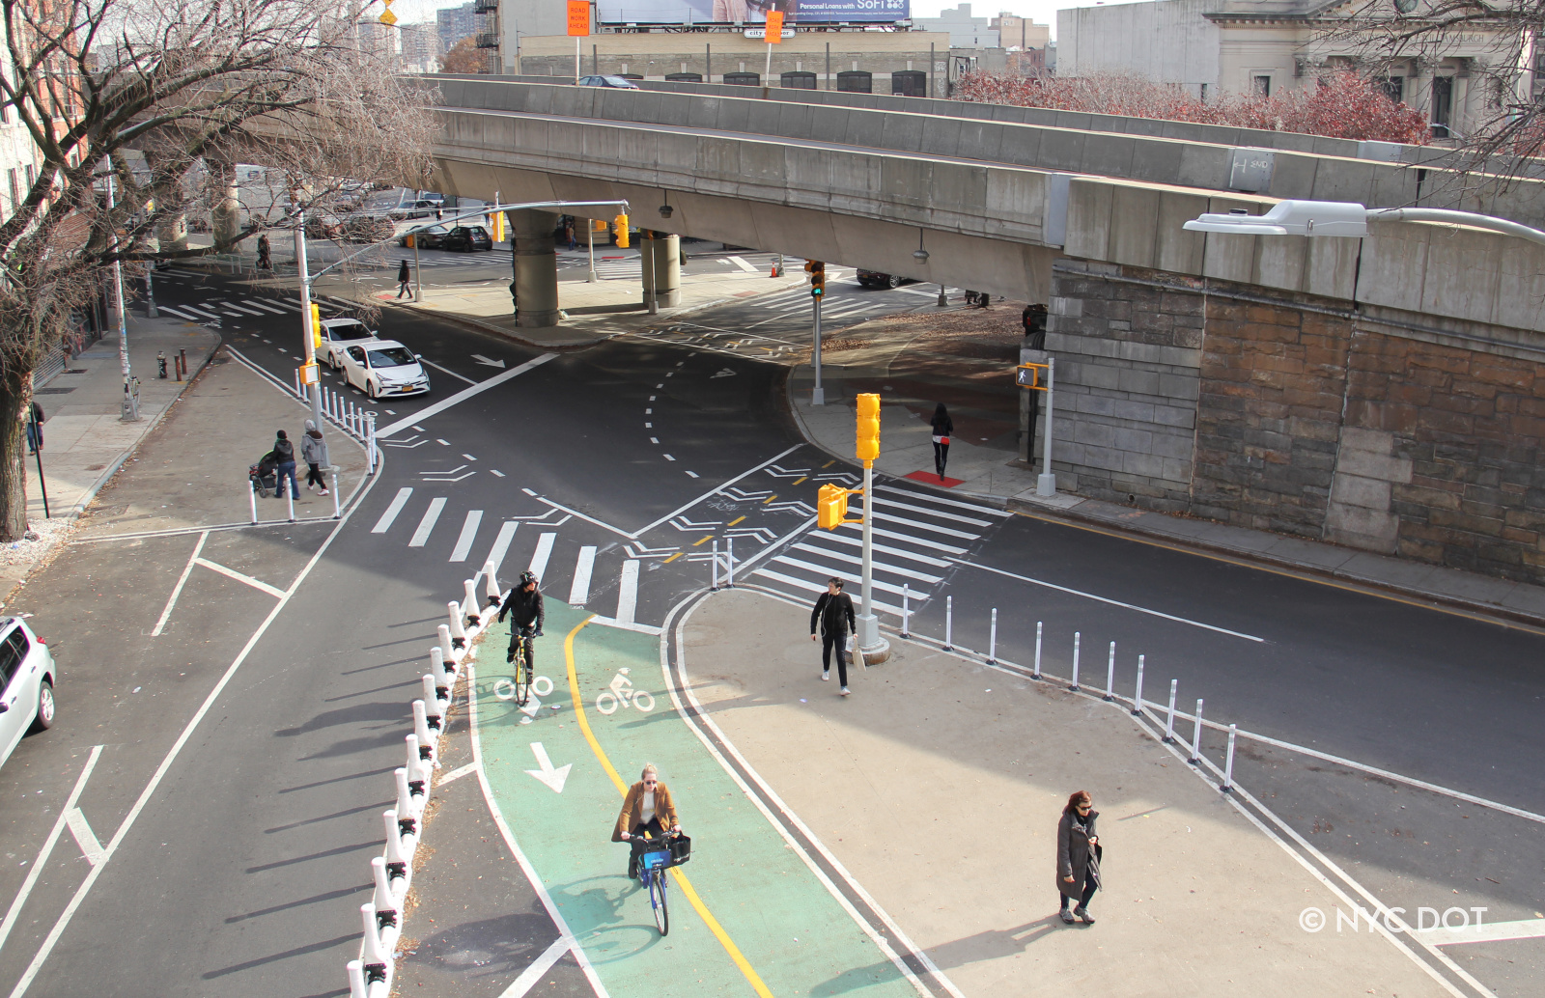
Street Improvement Projects (SIP)
Before
Before
After
Focus on safety, accessibility, and mobility for all users
Utilize inexpensive materials and in-house resources
Diverse set of projects
+/- 100 projects a year
Before
After

Slide 3
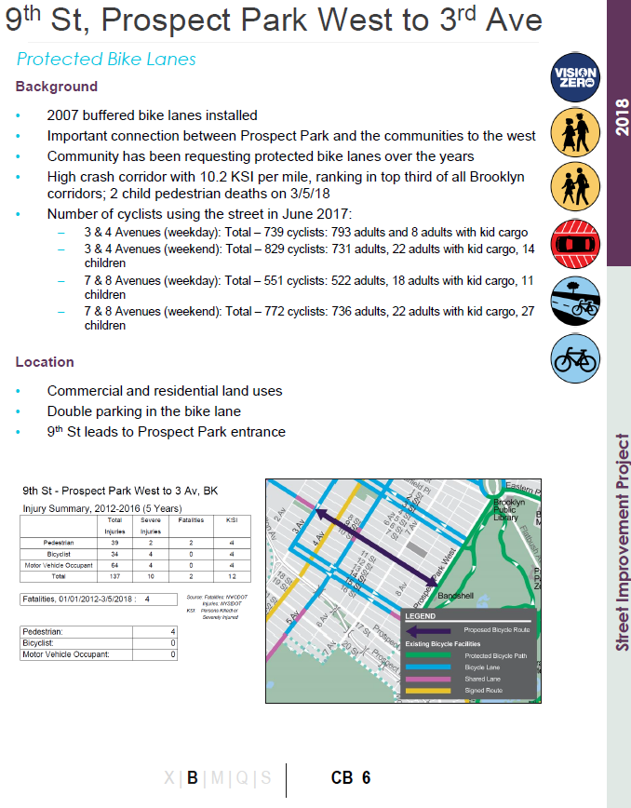
Sip Project tracking
SIP Tracking challenges
Scattered details
Non-standardized tracking metrics
Reliance on institutional memory
Limited treatment data
Analysis and reporting challenges
Data availability
Data compatibility
Data reliability

Slide 4
Data model
Diversity of treatment complexity
Flexibility for changing treatment designs
Requires planning treatment relationships

Slide 5
Treatment preparation
Organize treatment details into hierarchy
All possible paths need to be accounted for
Treatments can have varying levels of detail

Slide 6
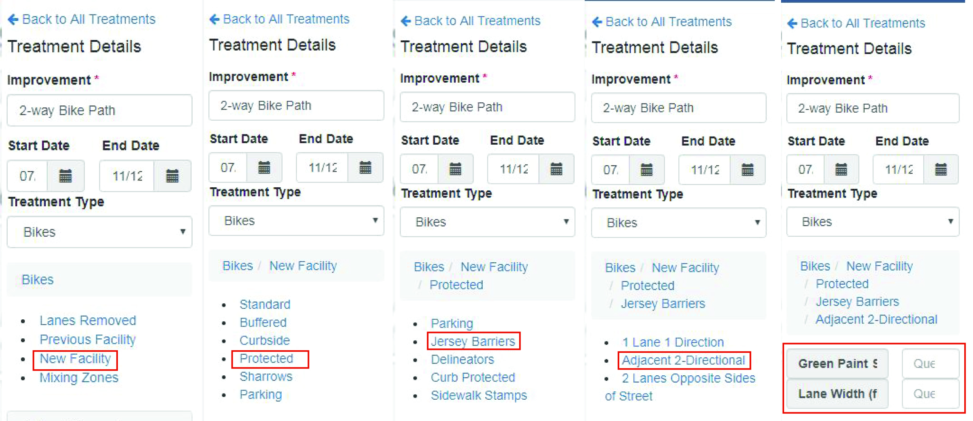
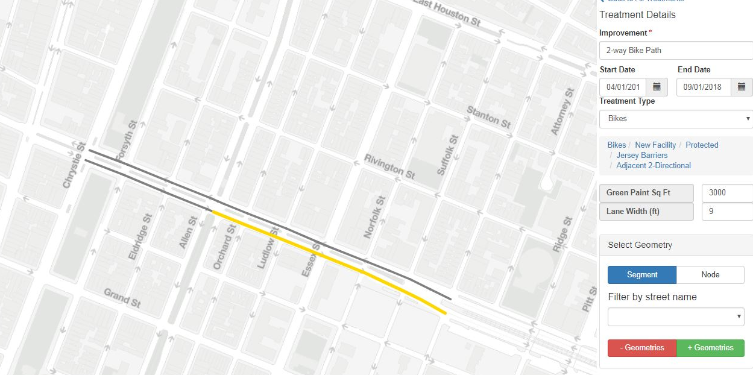
Data entry
Treatment attributes:
Selected from decision trees
Simple choices at each stage
Treatment geometry:
Select applicable road segments
Standardized mapping

Slide 7
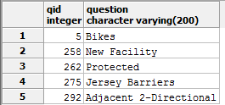
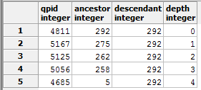
Database
Treatment Details
Treatment table with every option and detail
Treatment relationship table
Treatment details stored in a single record
Treatment Relationships
Project Treatments

Slide 8
Search
Project details
Geography details
Treatment details

Slide 9
Dashboard
Program progress
Program planning
Systematic analysis

Slide 10
Thank you
NYCDOT
nyc_dot
nyc_dot
NYCDOT

